Slide 1
A REPORT ON STUDENT INDUSTRAL WORK EXPERIENCE SCHEME(SIWES) AT HRI-WEST-AFRICAL 10TH JULY, 2019 TO DECEMBER, 2019 WRITTEN BY NAME: AYIM LIVINUS ABIP REG. NO 16/CSC/025 DEPT: COMPUTER SCIENCE FACULTY: PHYSICAL SCIENCE SUBMITTED TO MR. PRINCE ANNA (IT COORDINATOR) DEPARTMENT OF COMPUTER SCIENCE IN PARTIAL FULFILLMEMENT OF THE REQUIREMENT FOR THE INDUSTRIAL TRAINING PROGRAMME, DEPARTMENT OF COMPUTER SCIENCE JANUARY, 2020

Slide 2
INTRODUCTION BACKGROUND OF THE COMPANY This internship was carried out at HRI-West-Africa Ltd. HRI-West-Africa Ltd is a private limited Health Information and IT Solution company. Founded in 2002 by seasoned Medical and IT professionals. They carry out training, consultancy services and supplies to educational institutions, Government organizations, Private companies and individuals. HRI-West-Africa Ltd has been prequalified by over 50 big organizations in Nigeria, and it has completed several projects spnaing IT and health related services including Networking and software developments. HRI-West-Africa Ltd has offered Internship training to over 1000 students from different universities and these include Cross River University of Technology, University of Calabar and others.

Slide 3
HRI-WEST-AFRICA LTD ORGANIZATIONAL STRUCTURE
Board Of Directories
Management
Training
Research
ICT
Work Shop
Computer
Maintenance
Software
Cafe
Networks

Slide 4
WHAT I LEARNT
INTRODUCTION TO COMPUTER
Installations of windows operating system
Assembling
Repairs
Maintenance
PROGRAMING
Android Development
Web Development
NETWORKING
Termination of Ethernet cables
Site survey and design
Switch and router configuration
Multiple vlan configuration

Slide 5
WHAT I ACHIEVE
PROGRAMMING
Web design,
I developed a mailing system for bulk email sending emails massages to more than one emails
LANGUACH USE TO DEVELOP THE SYSTEM
HTML5
CSS5
JAVASCRIPT
PHP

Slide 6
HOW DOES THE SYSTEM WORKS
All email to be send a message most be registered to the system be the process of sending a bulk email can be achieve

Slide 7
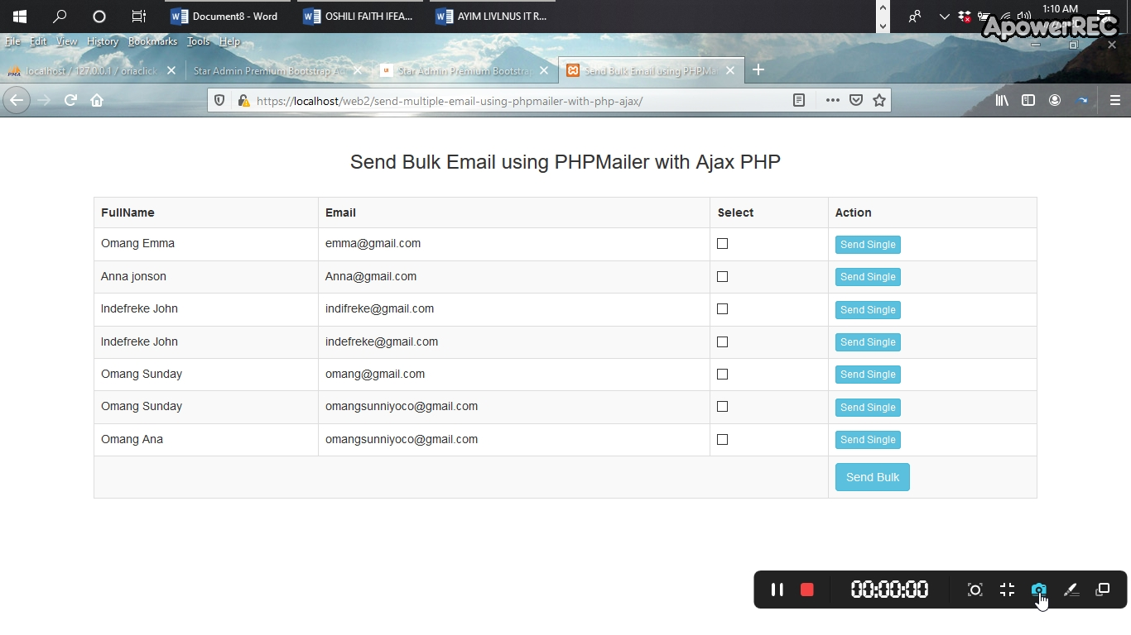
INTERFACE OF THE SYSTEM

Slide 8
CONCLUTION
I conclude by giving my sincere thanks to the Merciful GOD who has enabled me go through this internship training successfully and the management of the HRI-WEST-AFRICA LTD for the excellent work done. I wish anyone in the field of Computer Science not to miss out on the services provided by HRI-WEST-AFRICA LTD because students acquire whatever skill is needed in the field of working. Internship training has enabled me to gain new insight and more comprehensive understanding about the real information technology skills such as networking, troubleshooting, software installation, information security, website development among others and this training provided me with the opportunity to develop and improve my personal skills, know how to deal with different people. Therefore, it has been so interesting, helpful and challenging. And I don’t regret having trained at HRI-WEST-AFRICA LTD.

